Slide 1

Welcome to grade 12
Subtitle

Slide 2
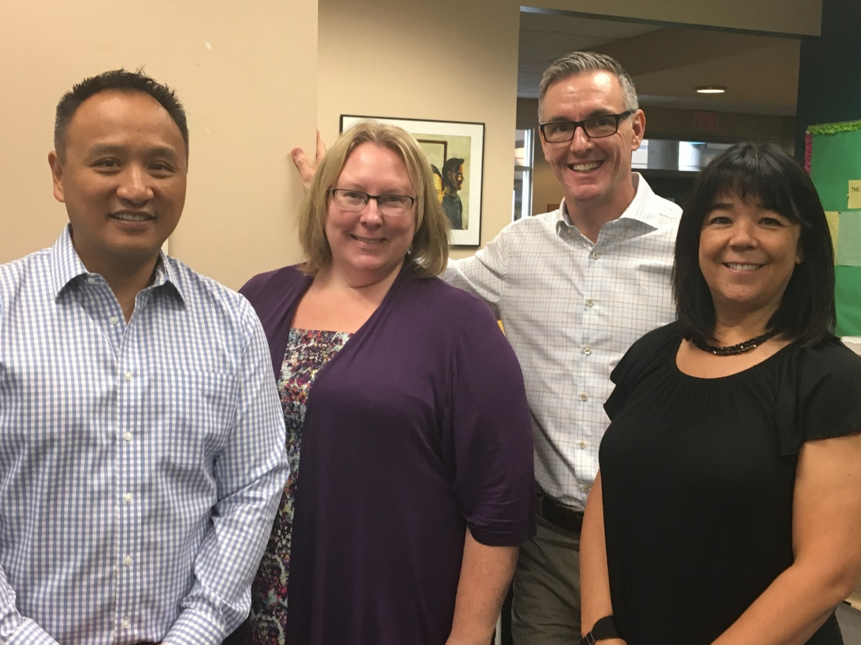
ADMIN
TEAM
PRINCIPAL
MR. COBER
VICE-PRINCIPALS
MS. POTTER-SMITH (A-H)
MR. CHAN (I-P)
MS. CUELLAR (Q-R)

Slide 3
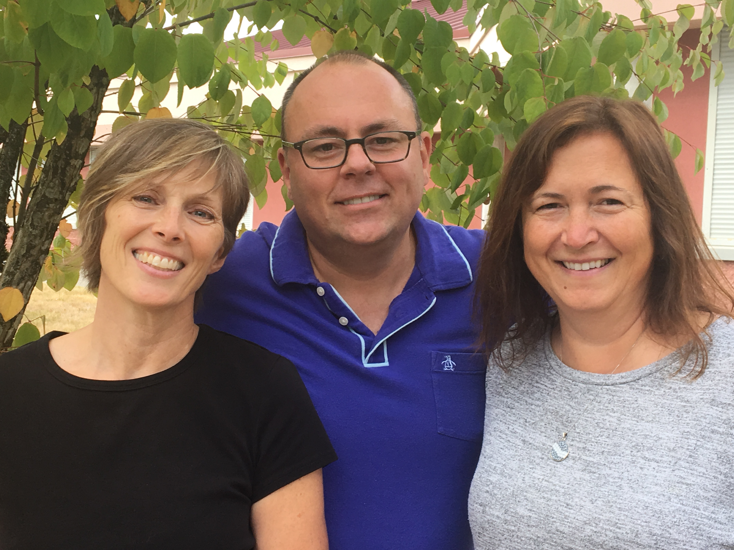
Counselling team
MR. HENRY (A-H)
MS. BUTTERFIELD (I-P)
MS. DUARTE (Q-Z)

Slide 4
Youth workers and career facilitator
MS. SALAS, Youth Worker
MS. JEONG, International Korean Youth Worker (Wednesday)
MS. HONG, International Mandarin Youth Worker
(Monday, Tuesday)
MS. CARRIE CLARK, Aboriginal Youth Worker
MS. SABRINA HAYWARD, SHARE (Wednesday)
MS. AUSTMAN, Career Facilitator

Slide 5
CUSTOMIZED LEARNING (CL)
BLOCK | CUSTOMIZED LEARNING (CL) (73min classes)
1 | 8:00 - 9:13
2 | 9:18 - 10:31
CL | 10:36-11:06 (30 min)
3 | 11:11 - 12:24
LUNCH | 12:24 - 1:04
4 | 1:09 - 2:22
5 | 2:27 - 3:40
Y | 3:45 - 4:58

Slide 6
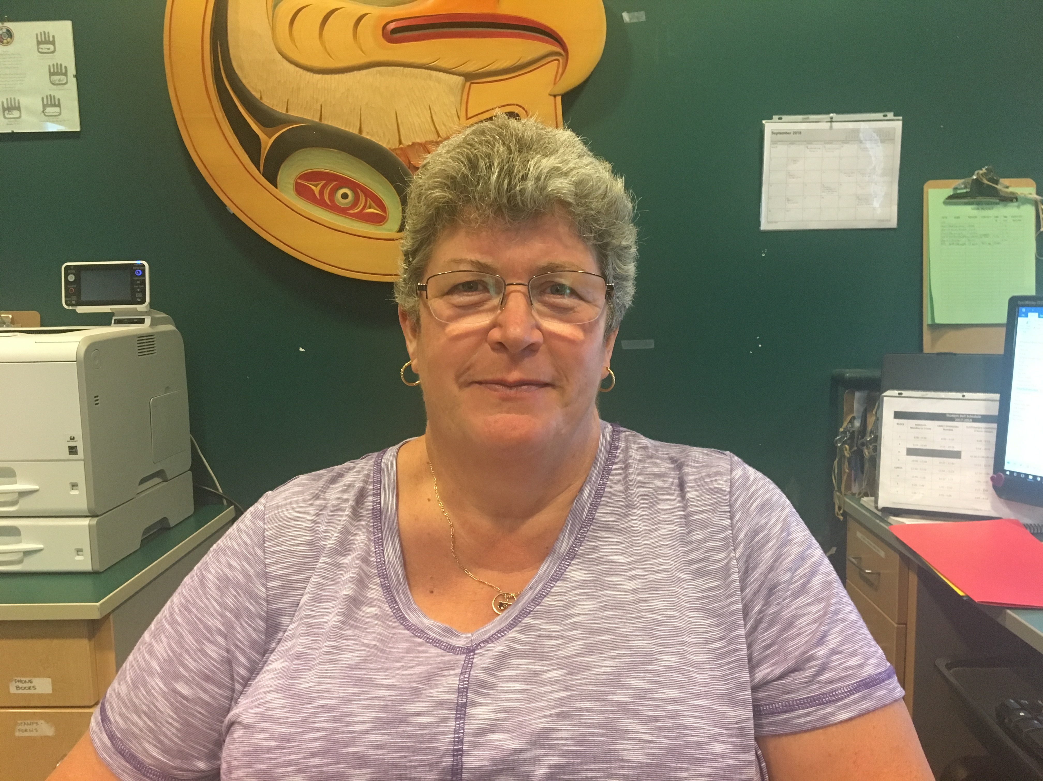
SIGN OUT PROCEDURES
FOR
ASSIGNED TIME
All students must sign out at the office (with parent/guardian permission) with Ms. Yahemech in order to leave the school during their assigned time in blocks 2, 3, and 4.
Parent permissions will be accepted by a letter/email or phone call to Ms. Yahemech – no text messages will be accepted.
*year long permission is available

Slide 7
COURSE CHANGES
Step 1 – Do I qualify?
All course changes were done in the spring therefore, generally, we are not doing course changes. There are some very specific scenarios where we will make changes if there is room in a class:
□ Need to fulfill graduation requirements
□ Post-secondary requirements have changed. Provide details: _______________
□ Less than 8 courses
□ Placed in the incorrect course level (i.e. English 11 before English 10)
□ Completed a summer/online course
**If you are in an alternate elective it is because your first-choice elective cannot be accommodated.

Slide 8
COURSE CHANGES
Step 2 – Requesting a change?
Pick up a Course Change Form today in the main foyer (or download and print from APP)
Take the form home and get it signed
Bring the signed form to see your counsellor as per the times listed below.
Before or after school, at lunch or during your “off-block” as per the schedule below:
Wednesday Sept. 5 Grade 12’s
Thursday Sept. 6 Grade 11’s
Friday Sept. 7 Grade 9’s, 10’s
Monday/Tuesday Sept. 10/11 All grades
**All course changes will be complete by Wednesday, September 12th.
**No course requests will be accepted via e-mail.

Slide 9
COURSE CHANGES
*In Work Experience 12A and see a conflict? – Ms. Cuellar has your solution!

Slide 10

Gleneagle App
DELETE former app called “GLENEAGLE”
INSTALL app called “MY SCHOOL DAY” and follow the set up prompts to select Gleneagle Secondary
The Gleneagle app is your key location for information and announcements as well as your daily bell schedule and calendar events!!

Slide 11
Senior sail tickets
Tickets are now on sale and can be purchased online using
School Cash Online
Website: https://sd43.schoolcashonline.com/
Senior Sail is for grade 12 students only (no guests permitted for this event)

Slide 12
GRADE 12 WINGS
Wings | Student Last Name | Teacher | Room #
W-01 | A - BE | Galliford, Ms. B. | 218
W-02 | BF - CHEN | Clayton, Mr. J. | 220
W-03 | CHO - DAZ | Grega, Ms. M. | 221
W-04 | DE - GA | Scott, Mr. T. | Gym
W-05 | GE - HE | Linburg, Mr. T. | 224
W-06 | HI - JAZ | Hunter, Mr. B. | 215
W-07 | JE - KIM | Liao, Mr. M. | 205
W-08 | KIN - LEE | Ramogida, Mr. R. | MPR 130
W-09 | LEF - MAE | Demonte, Ms. B. | Gym
W-10 | MAF - NEZ | Bennett, Ms. M. | 101
W-11 | NF - PAZ | Cecchini/Leblond | Library
W-12 | PE - SAZ | Unger, Mr. B. | 124
W-13 | SC - SONG | Maller, Mr. J. (Clausen) | 131
W-14 | SOO - TI | Simmons, Mr. M. | 212
W-15 | TO - WAN | Udell, Ms. M. | 226
W-16 | WA0 - YEE | Cooper, Ms. K. | 114
W-17 | YEF - ZHAN | Findley, Mr. S. | 111
W-18 | ZHAO - ZZ | Anderson, Ms. P. | Gym

